Slide 1
Item Respond Theory – Introduction
Wright and Stone (1979)
The purpose of a test is to measure a construct/variable/trait.
Items are operational definition of this construct/variable.
We need to establish that the intended construct is in fact realized by the test items.
In order to do this, give the test to a sample of individuals and analyze responses to see if items fit together to define the construct of interest.
And locate an individual’s position on the latent continuum.
_Low________________________________*(individual)__________________________________________________High__

Slide 2
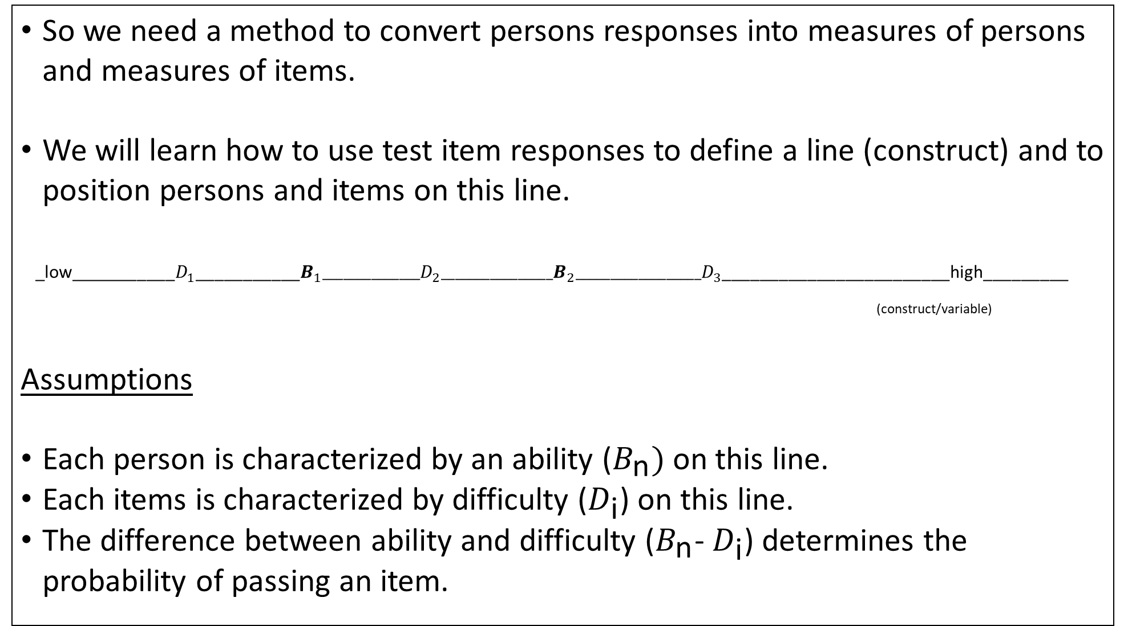
So we need a method to convert persons responses into measures of persons and measures of items.
We will learn how to use test item responses to define a line (construct) and to position persons and items on this line.
_low___________$D_{1}$___________$B_{1}______________D_{2}________________B_{2}__________________D_{3}$________________________high_________
(construct/variable)
Assumptions
Each person is characterized by an ability ($B_{\text{n}})$ on this line.
Each items is characterized by difficulty ($D_{\text{i}}$) on this line.
The difference between ability and difficulty ($B_{\text{n}}$- $D_{\text{i}}$) determines the probability of passing an item.

Slide 3
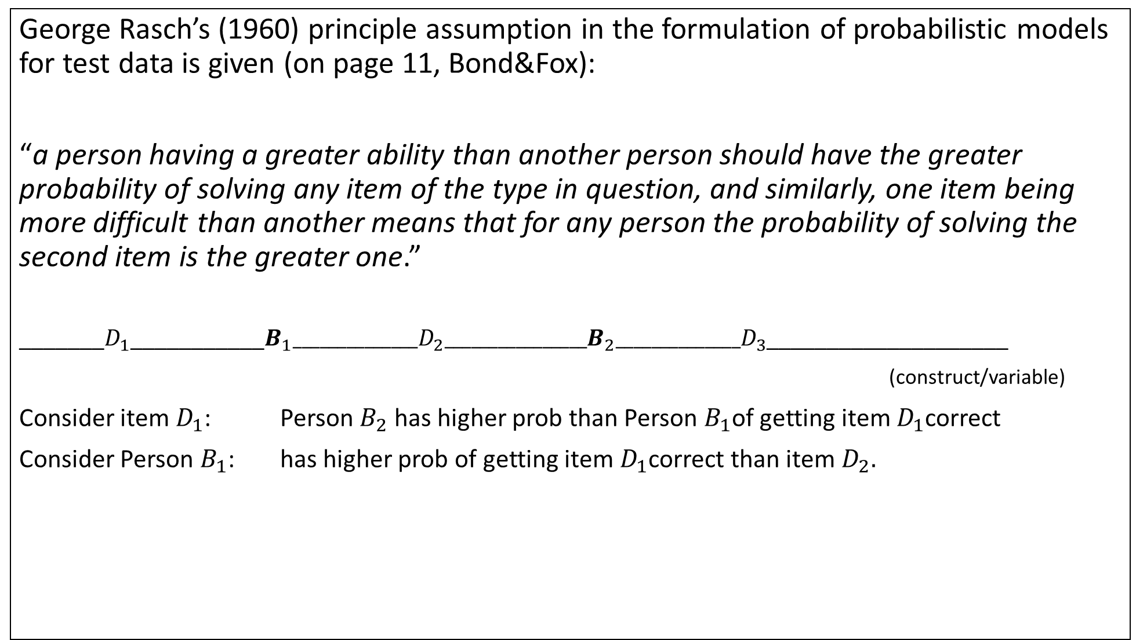
George Rasch’s (1960) principle assumption in the formulation of probabilistic models for test data is given (on page 11, Bond&Fox):
“a person having a greater ability than another person should have the greater probability of solving any item of the type in question, and similarly, one item being more difficult than another means that for any person the probability of solving the second item is the greater one.”
_______$D_{1}$___________$B_{1}______________D_{2}________________B_{2}______________D_{3}$____________________
(construct/variable)
Consider item $D_{1}$: Person $B_{2}$ has higher prob than Person $B_{1}$of getting item $D_{1}$correct
Consider Person $B_{1}$: has higher prob of getting item $D_{1}$correct than item $D_{2}.$

Slide 4
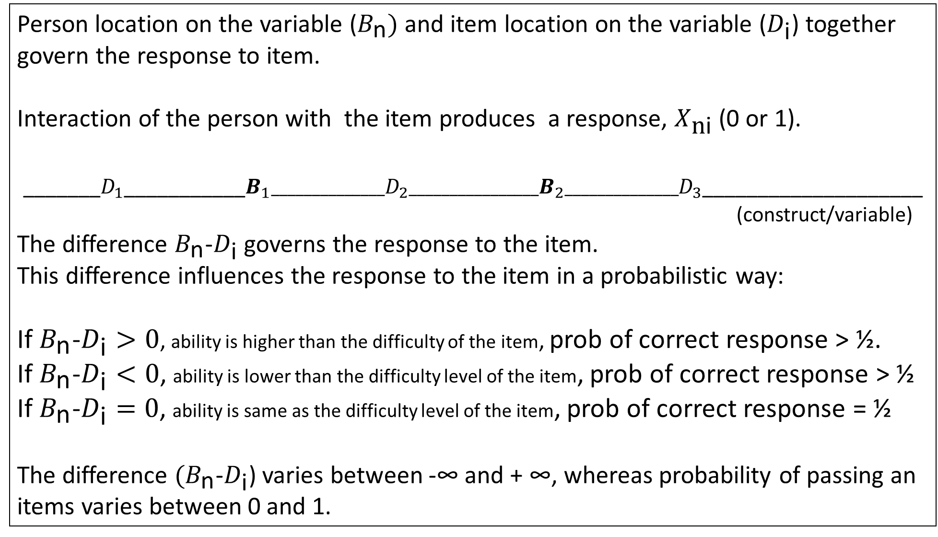
Person location on the variable ($B_{\text{n}})$ and item location on the variable ($D_{\text{i}}$) together govern the response to item.
Interaction of the person with the item produces a response, $X_{\text{n}\text{i}}$ (0 or 1).
_______$D_{1}$___________$B_{1}______________D_{2}________________B_{2}______________D_{3}$____________________
(construct/variable)
The difference $B_{\text{n}}$-$D_{\text{i}}$ governs the response to the item.
This difference influences the response to the item in a probabilistic way:
If $B_{\text{n}}$-$D_{\text{i}}>0$, ability is higher than the difficulty of the item, prob of correct response > ½.
If $B_{\text{n}}$-$D_{\text{i}}<0$, ability is lower than the difficulty level of the item, prob of correct response > ½
If $B_{\text{n}}$-$D_{\text{i}}=0$, ability is same as the difficulty level of the item, prob of correct response = ½
The difference ${(B}_{\text{n}}$-$D_{\text{i}}$) varies between -∞ and + ∞, whereas probability of passing an items varies between 0 and 1.

Slide 5
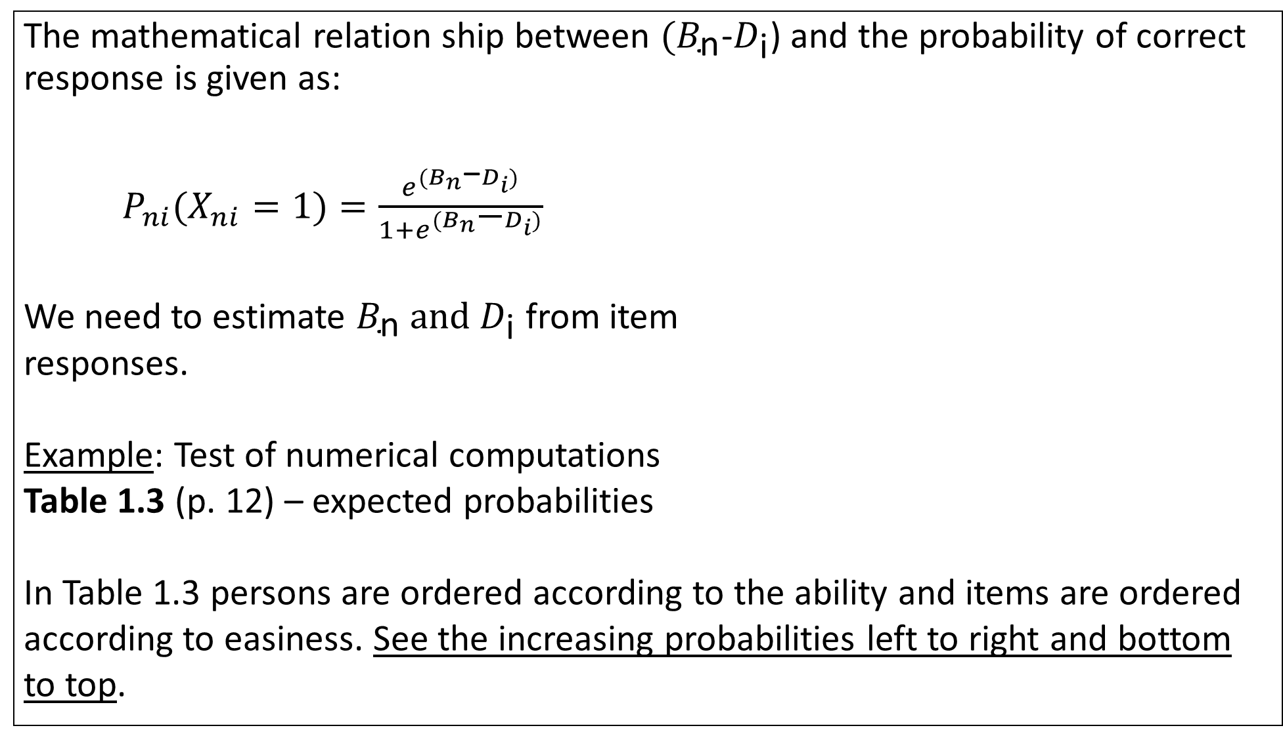
The mathematical relation ship between ${(B}_{\text{n}}$-$D_{\text{i}}$) and the probability of correct response is given as:
$P_{ni}(X_{ni}=1)=\frac{e^{{(B}_{n}\text{−}D_{i})}}{1+e^{{(B}_{n}\text{−}D_{i})}}$
We need to estimate $B_{\text{n}} and D_{\text{i}}$ from item
responses.
Example: Test of numerical computations
Table 1.3 (p. 12) – expected probabilities
In Table 1.3 persons are ordered according to the ability and items are ordered according to easiness. See the increasing probabilities left to right and bottom to top.

Slide 6
Rasch Principle
Interval-level measurement can be derived when the levels of some attribute increases with increases in the value of two other attributes.
That is, probability of correct response increases with increases in person ability and item easiness.
Rasch Measurement -- Focus is on the construction of a unidimensional scale that
follows interval-level measurement.
Person abilities are free of items; and item difficulties are free of the sample.

Slide 7
Estimation of person ability level
We need to know where a person is located on a variable of interest.
A reasonable place to estimate the person’s location is in the region where the responses shift from mostly correct on easier items to mostly incorrect on harder items.
So first we need to examine the pattern of responses and see if the pattern is consistent with how we expect.

